Slide 1
Hand and Pose Detection
COMPUTER VISION PROJECT BY:
UZOMA EWURUM

Slide 2

Introduction
Name: Uzoma Ewurum
Programme: Data Science
Cohort: 2023 November Cohort
Interest: Data Science, Computer Vision
Expectation:
We'll be discussing how I applied computer vision to detect hands and estimate poses in real-time.
https://www.linkedin.com/in/uzoma-ewurum

Slide 3
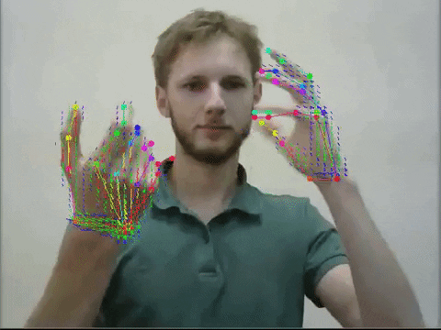
Computer Vision
Computer vision is a field of artificial intelligence that trains computers to interpret and understand the visual world.
RELEVANCE
Accurately Identify Objects
Classify Objects
React to what they see and recognize

Slide 4
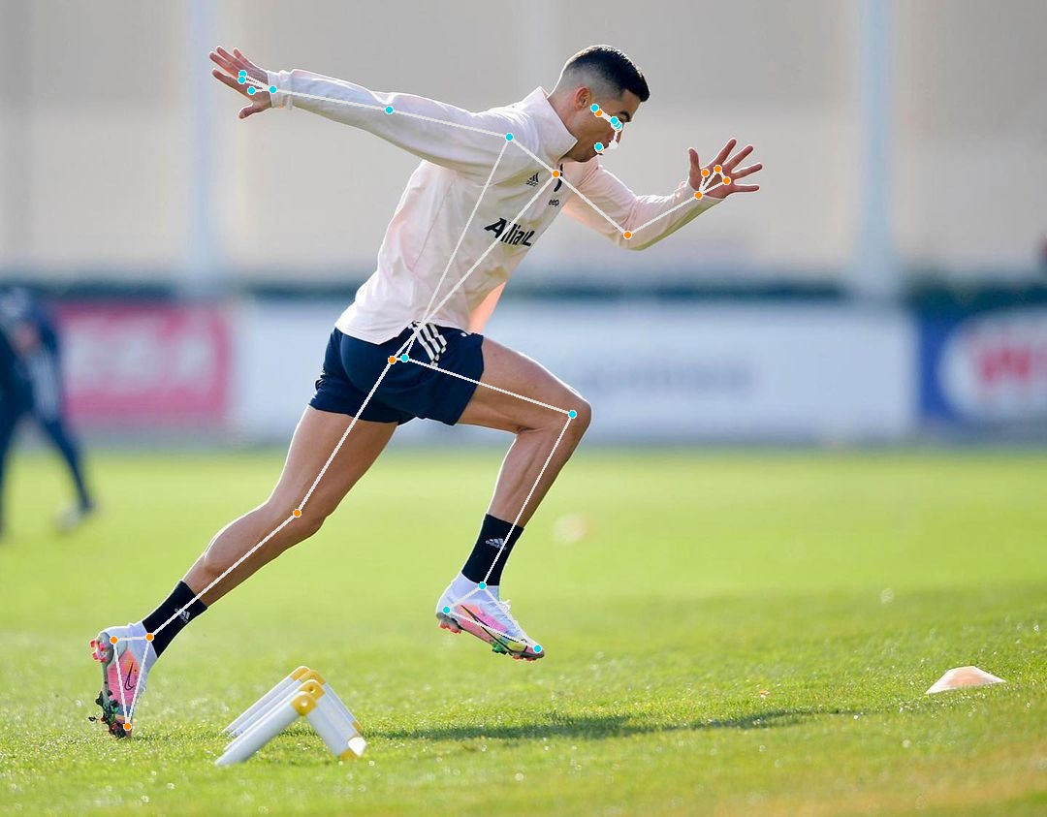
Project Overview
My goal was to create a system that can recognize and track hand movements as well as body pose movements using computer vision.

Slide 5
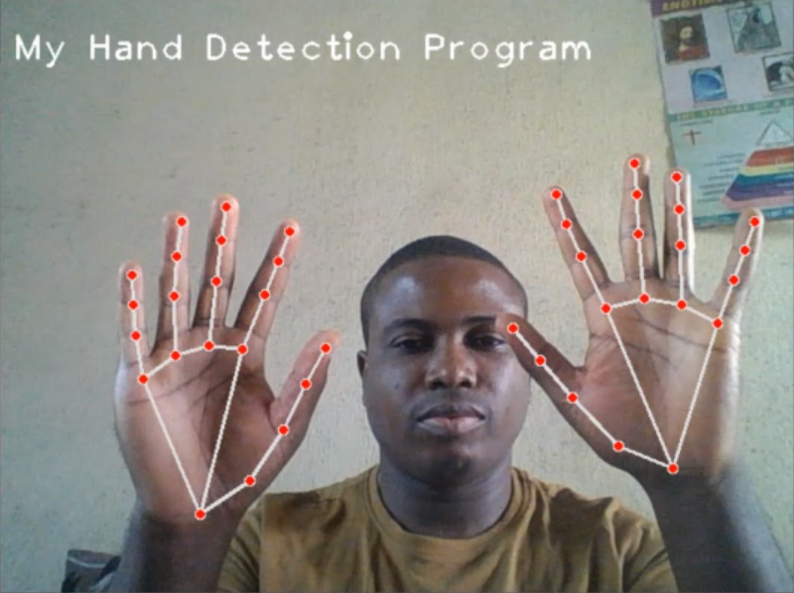
Hand Detection

Slide 6
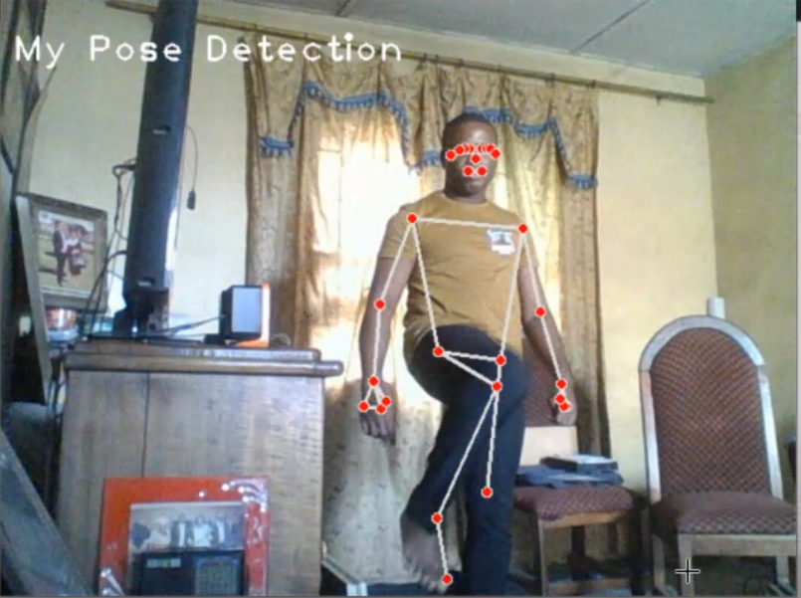
Pose Detection

Slide 7

APPLICATIONS
SUPER MARKET STORES
Reduce Customer Wait time
Reduce Down time
Enhance Customer Experience

Slide 8
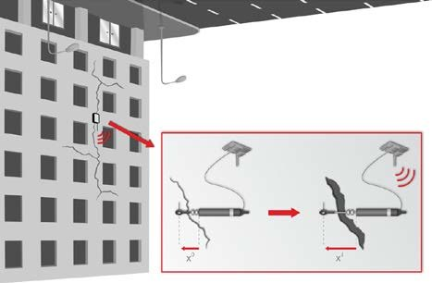
APPLICATIONS
CRACK DETECTION
Prevent loss of lives and property
Prevent loss of revenue

Slide 9

CONCLUSION
This technology has many potentials from enhancing Virtual reality experience to improving human computer interactions
Github:
https://github.com/uzilon/ComputerVision1

Slide 10
Thanks!!!

